Slide 1

TRACKING BARBELL EXCERCISE
Presented by : Darshan Parsoliya
STB03007
Submitted to: Scifor Technologies

Slide 2
TABLE OF CONTENT
Data Overview
Data Pre-processing
Exploratory Data Analysis (EDA)
Handling Outliers
Feature Engineering
Train & Test Model
Observations

Slide 3
Data Overview
Data Source:
* Utilizing MetaMotion sensors for data collection.
* Sensors include accelerometer and gyroscope modules.
Sensor Outputs:
* Accelerometer: Captures acceleration forces experienced by the sensor.
* Gyroscope: Measures the rate of rotation around different axes.
Dataset Information :
* Data collected from 5 individuals.
* Names of participants involved in the study.
* Labels assigned to each exercise (e.g., bench press, over head press, deadlift).
* Categorization based on exercise intensity (e.g., heavy, medium).
*Data recorded over 3 axes (x, y, z) for both accelerometer and gyroscope.

Slide 4
Data Pre-processing
Import & Organization:
Loaded MetaMotion sensor data (accelerometer & gyroscope) using Pandas.
Organized data over 3 axes (x, y, z) for both sensors.
Participants & Labels:
Gathered data from 5 individuals.
Extracted participant names, exercise labels, and conditions from file names.
Cleaning Steps:
Removed unnecessary columns: 'epoch (ms)', 'time (01:00)', 'elapsed (s)'.
Converted timestamp to datetime format for indexing.
Resampling Technique:
Applied resampling at a consistent 200ms interval.
Utilized mean for numerical data and last value for categorical data.
Checked and addressed missing values in the resampled dataset.
Concatenation & Overview:
Concatenated accelerometer and gyroscope data.
Explored resulting dataset with combined information.
Data Export:
Saved processed data to a pickle file for further analysis.

Slide 5
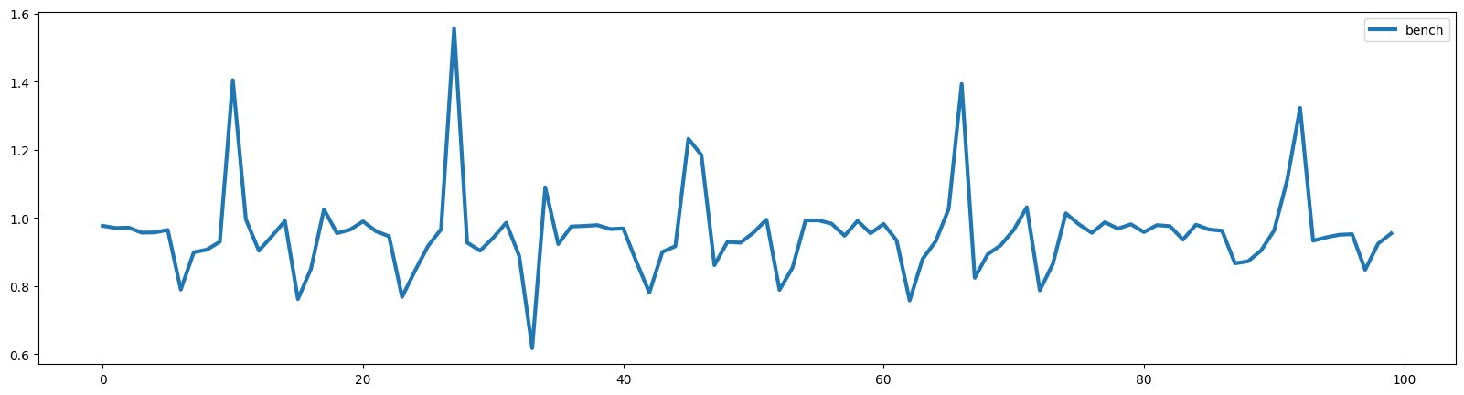
Exploratory Data Analysis (EDA)
Exercise-specific Visuals:
Delved into individual exercises, providing dedicated plots for each exercise label.
Focused on the 'acc_y' axis to capture exercise-specific patterns.
Subset Visualization (Limited Samples):
Displayed a snapshot of the first 100 samples for a more detailed view.
Concentrated on the 'acc_y' axis to observe variations.
Bench Press

Slide 6
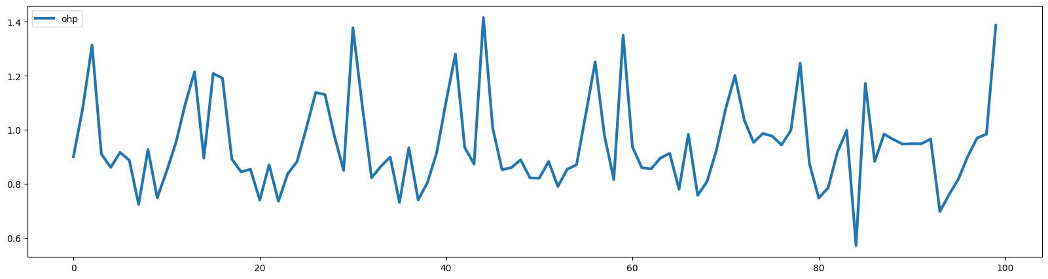
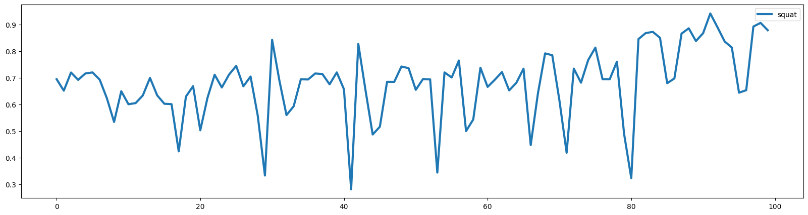
Over Head Press
Sqaut

Slide 7
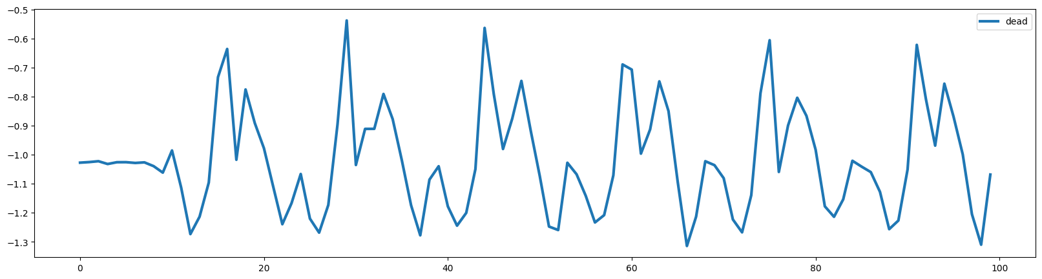
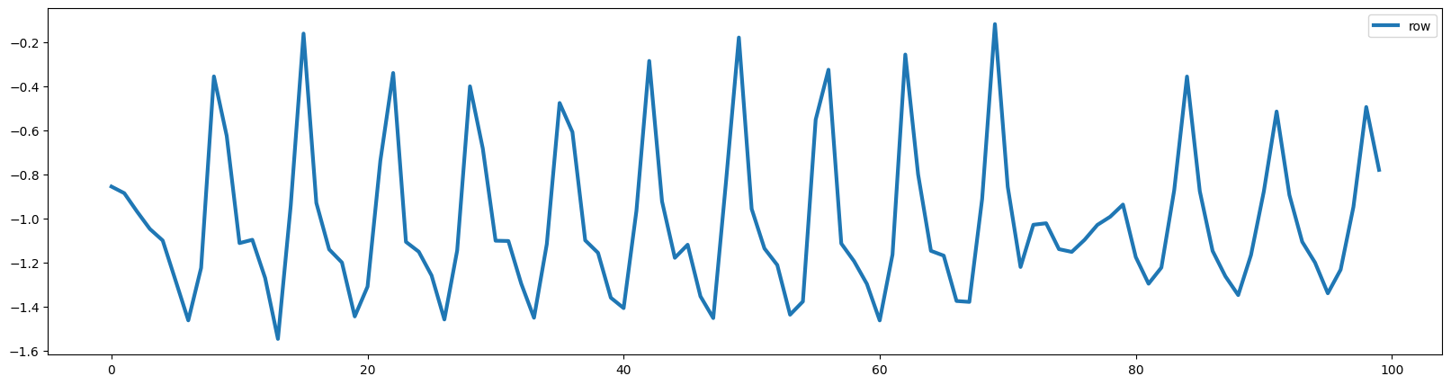
Deadlift
Row

Slide 8
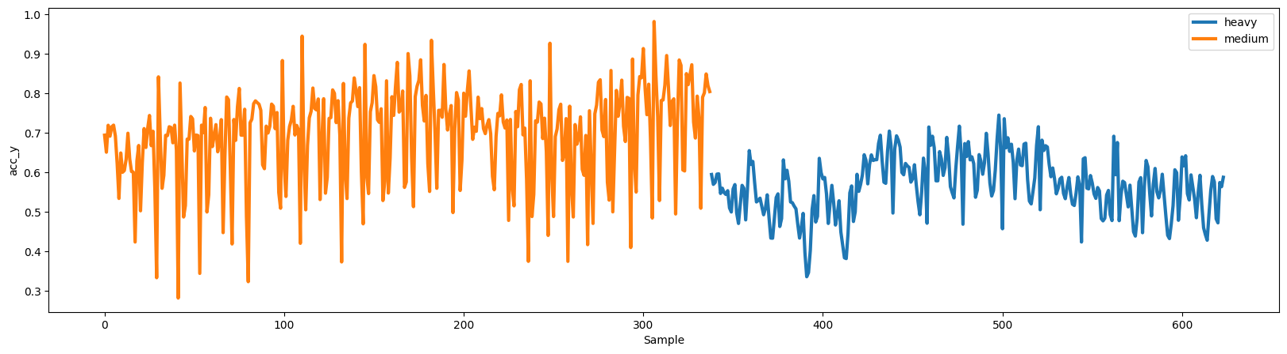
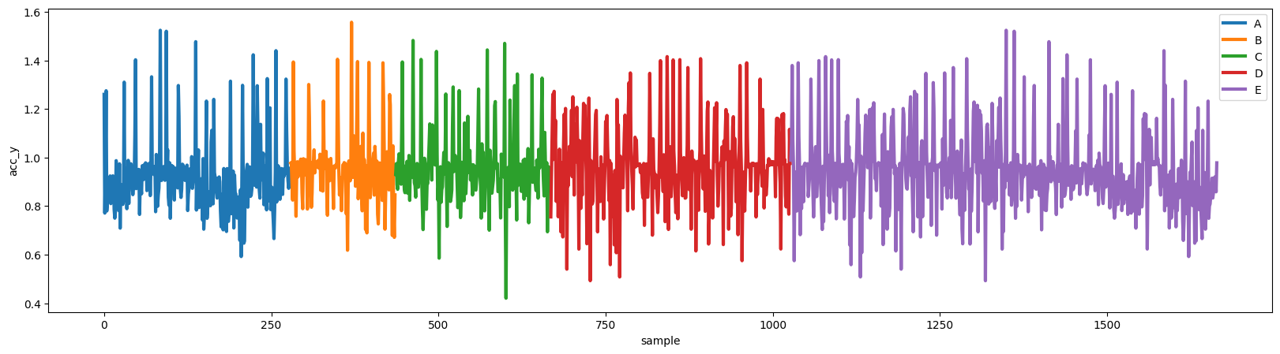
Category-wise Analysis (Squat):
Conducted a category-wise analysis by grouping and plotting 'squat' exercise data.
Examined variations under different conditions.
Participant-wise Analysis (Bench):
Investigated 'bench' exercise data, considering different participants.
Grouped by participant for a nuanced understanding.

Slide 9
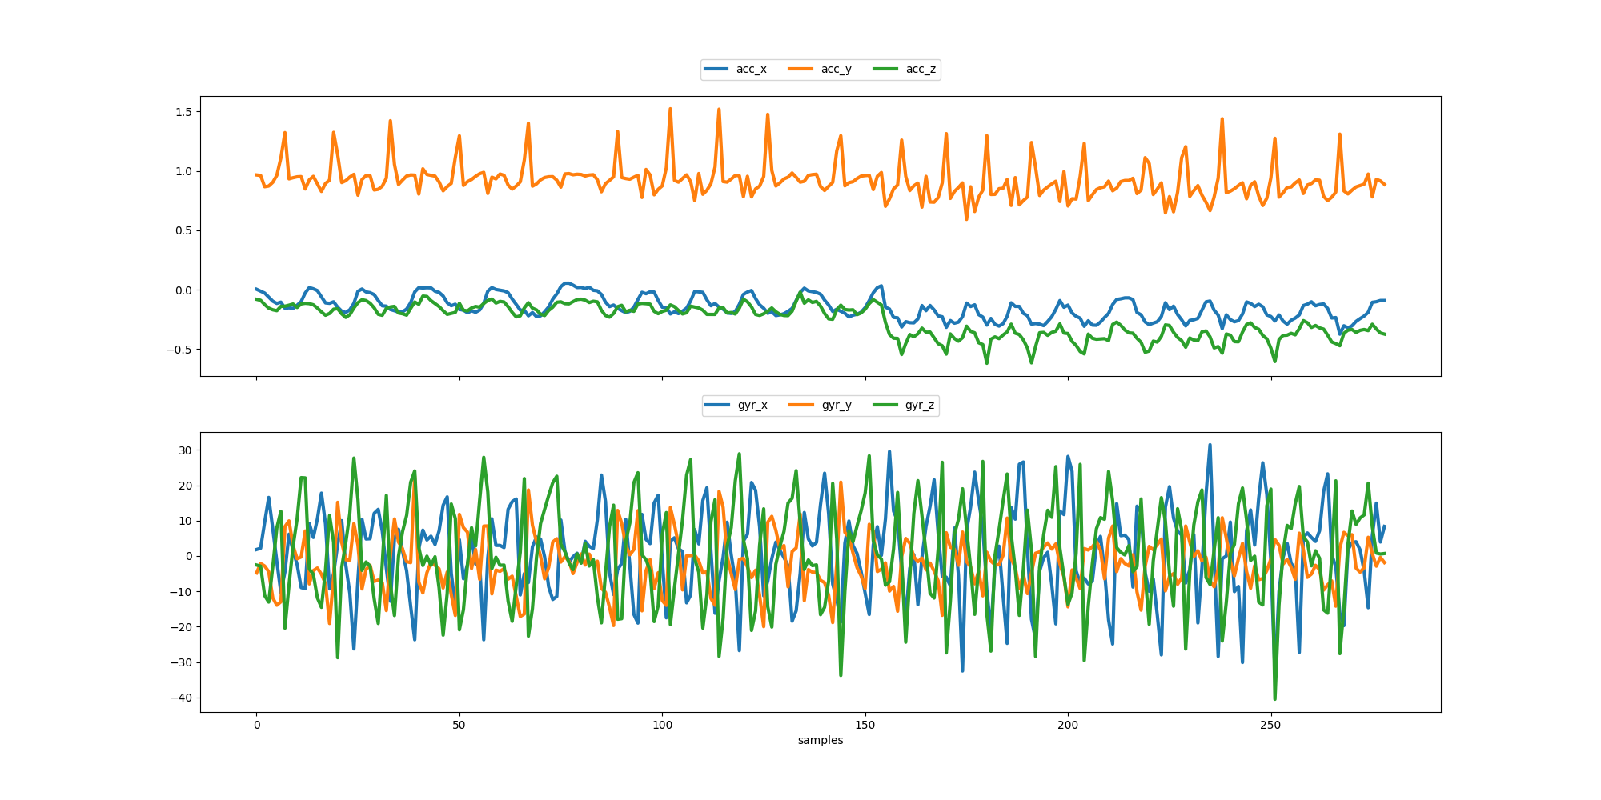
Combined Accelerometer & Gyroscope Plots:
Synthesized information by creating combined plots for both accelerometer and gyroscope data.
Enabled a holistic view of sensor readings.
For Analyse the Pattern we take for Visualization Participant A
Bench Press

Slide 10
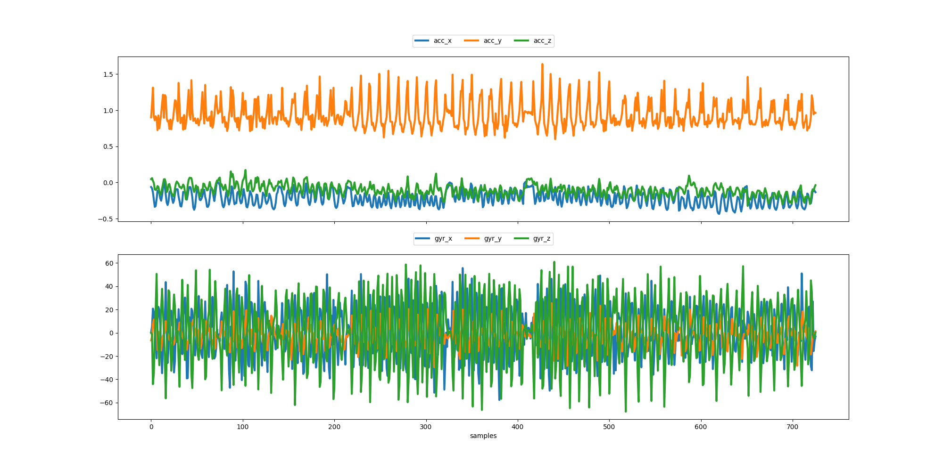
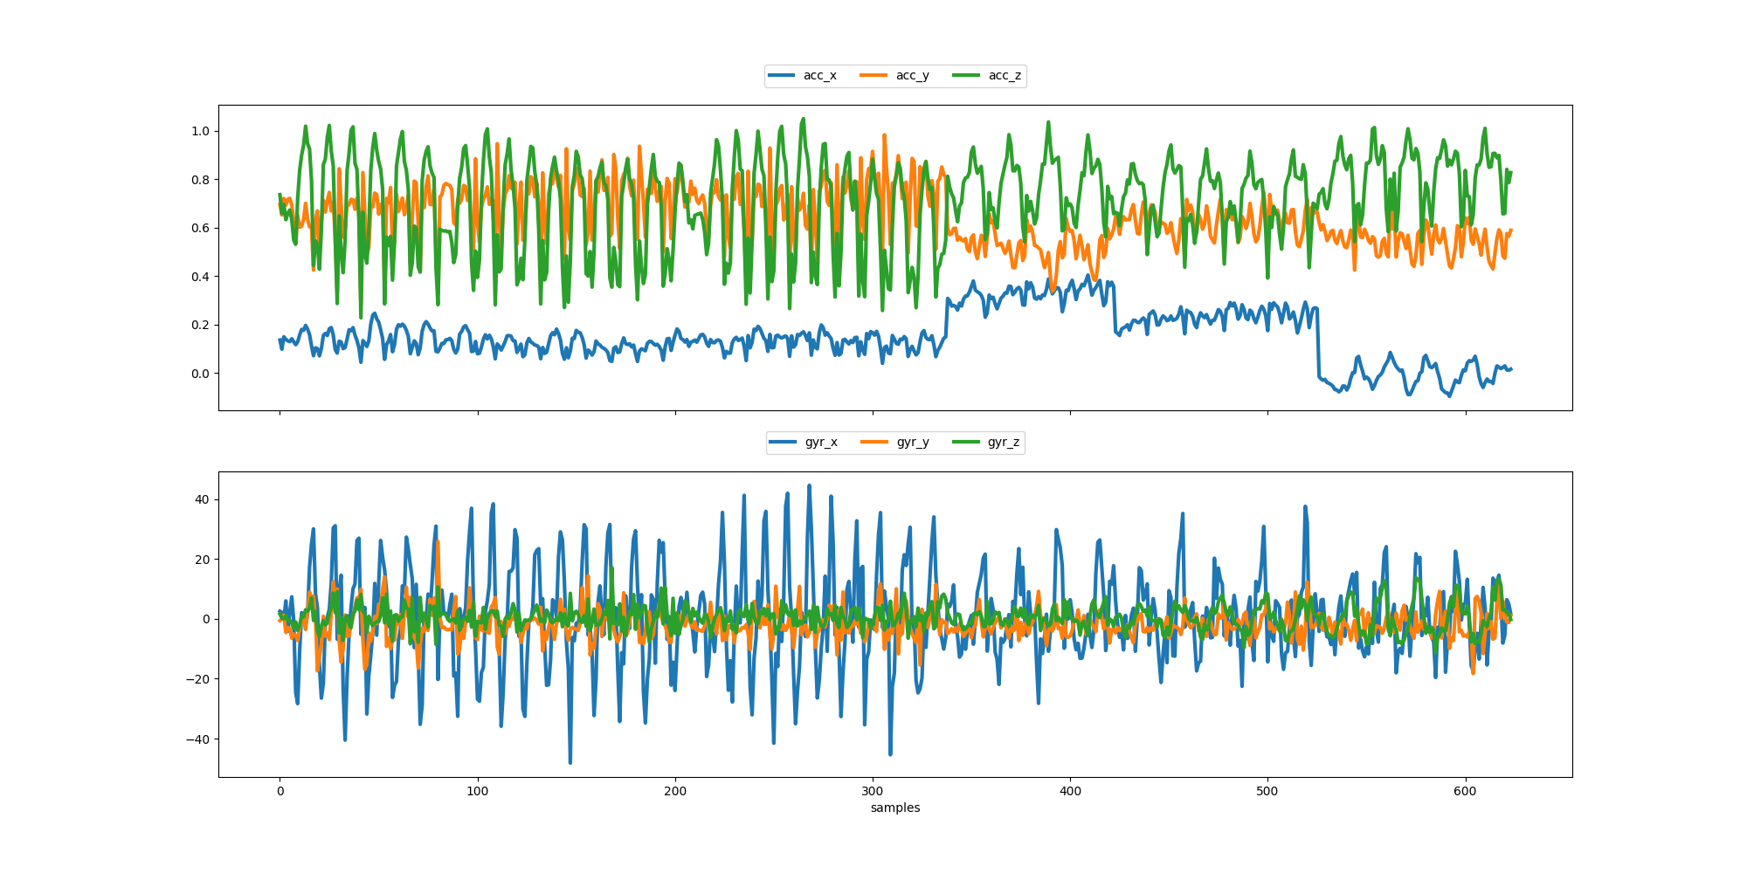
Over Head Press
Squat

Slide 11
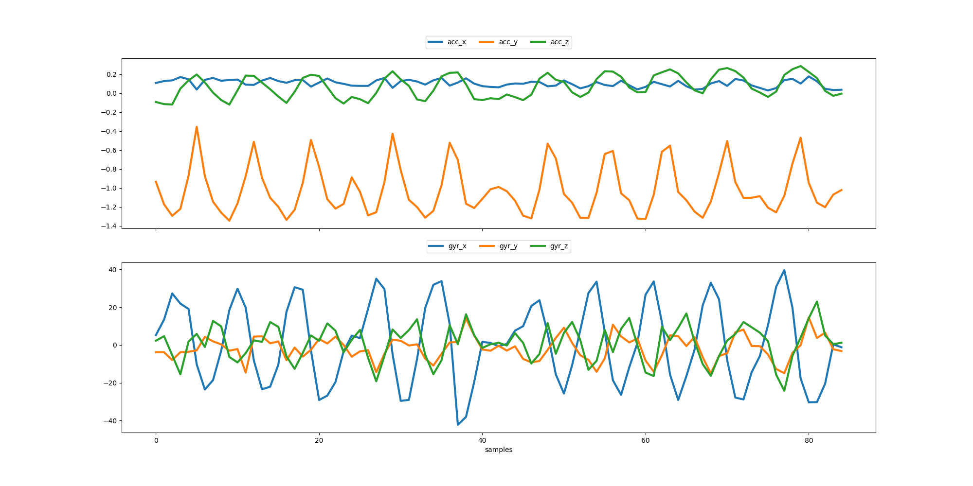
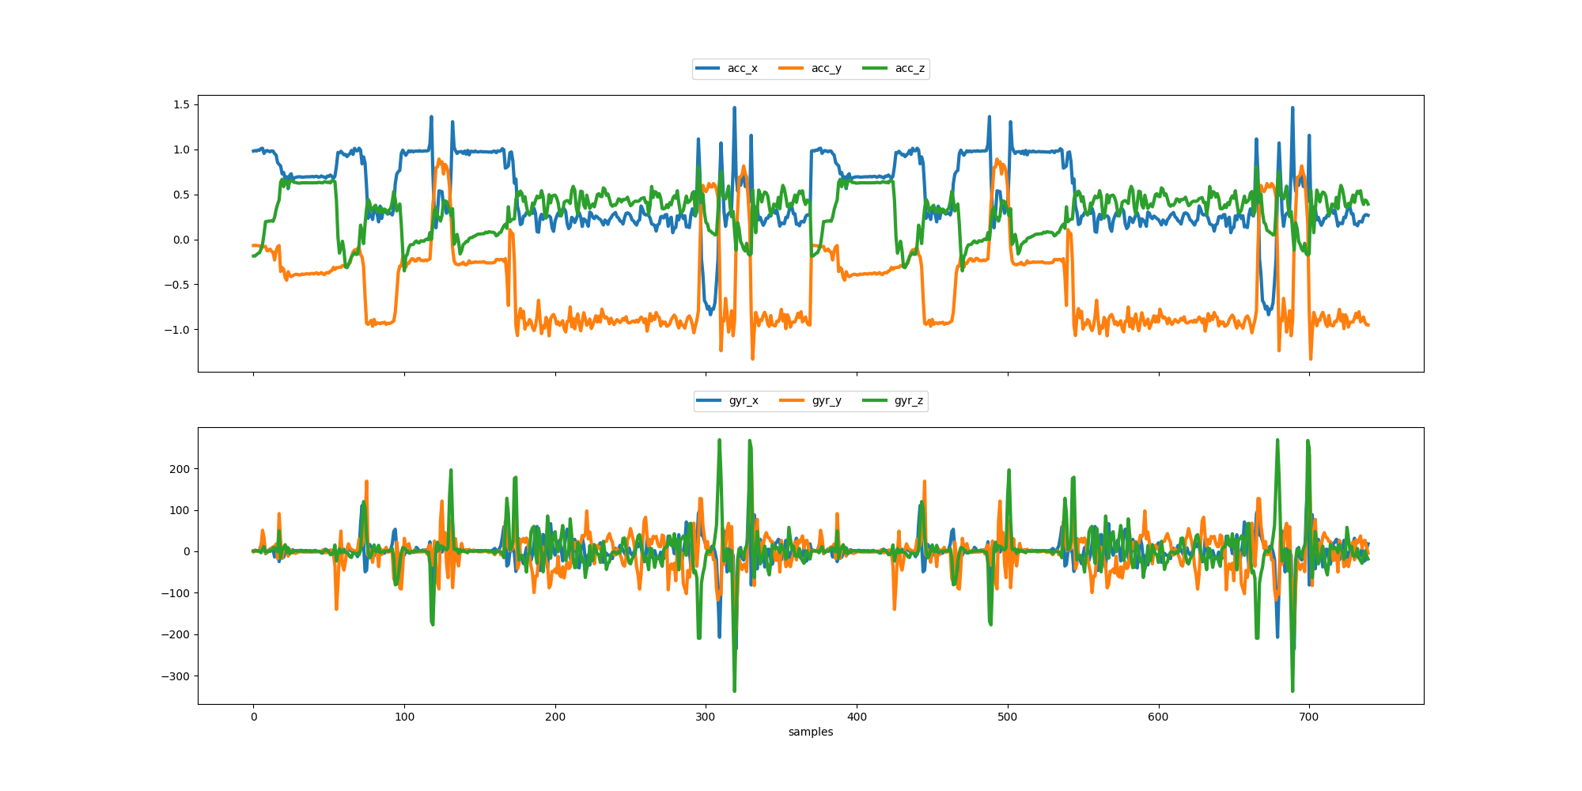
Row
Rest

Slide 12
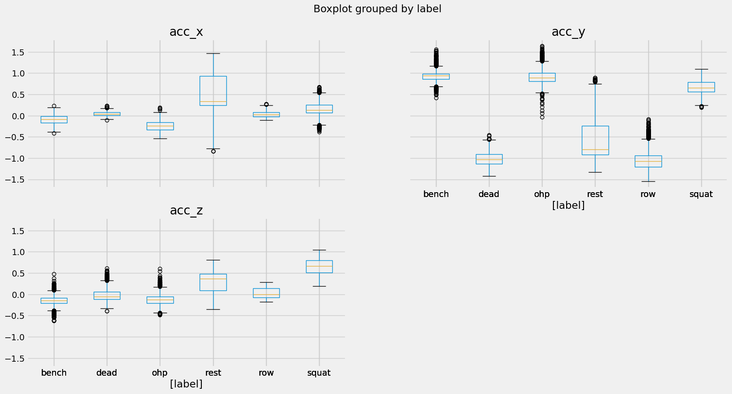
Handling Outliers
Subset Column :
['acc_x', 'acc_y', 'acc_z', 'gyr_x', 'gyr_y', 'gyr_z']
Outlier Detection Techniques:
Utilized various techniques, including IQR, Chauvenet's Criterion, and Local Outlier Factor (LOF) on subset
Visualized outliers through box plots and histograms.
Box Plots for outlier columns:
Explored outliers in subsetcolumns using box plots.
Identified variations in different exercise labels.

Slide 13
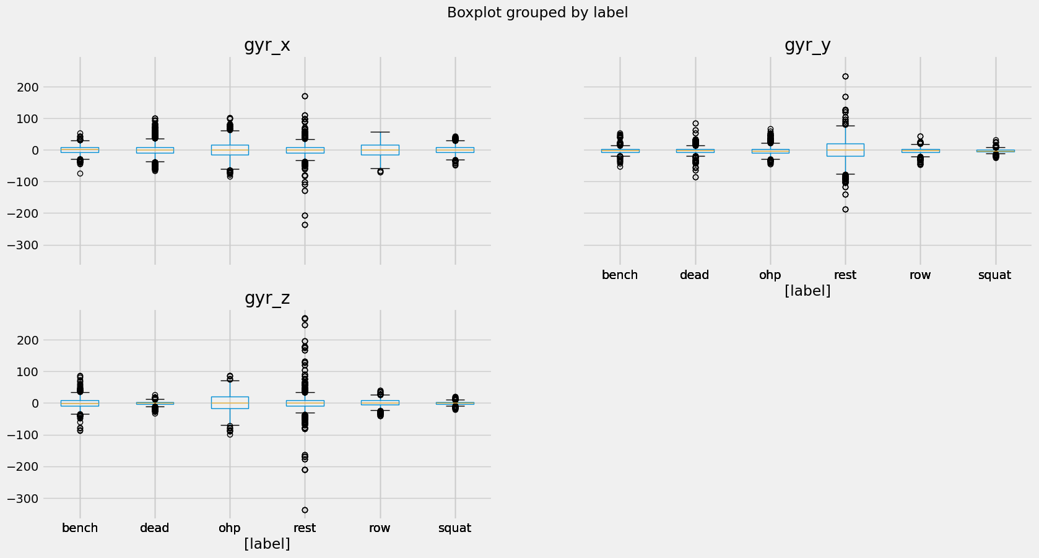
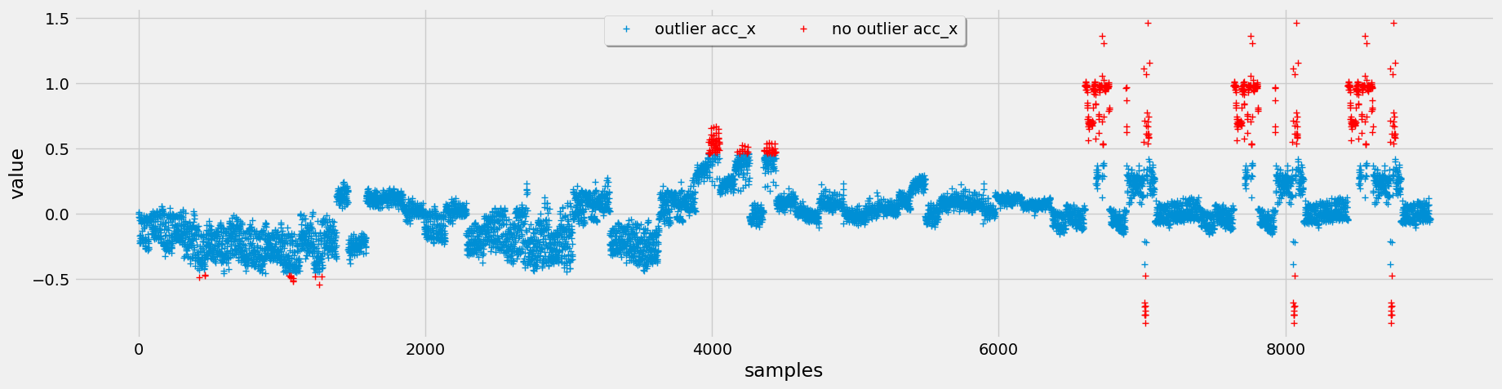
IQR Method for Accelerometer Data:
Applied the IQR method to identify outliers from subset columns .
Box plots showcased the distribution within each exercise label.

Slide 14
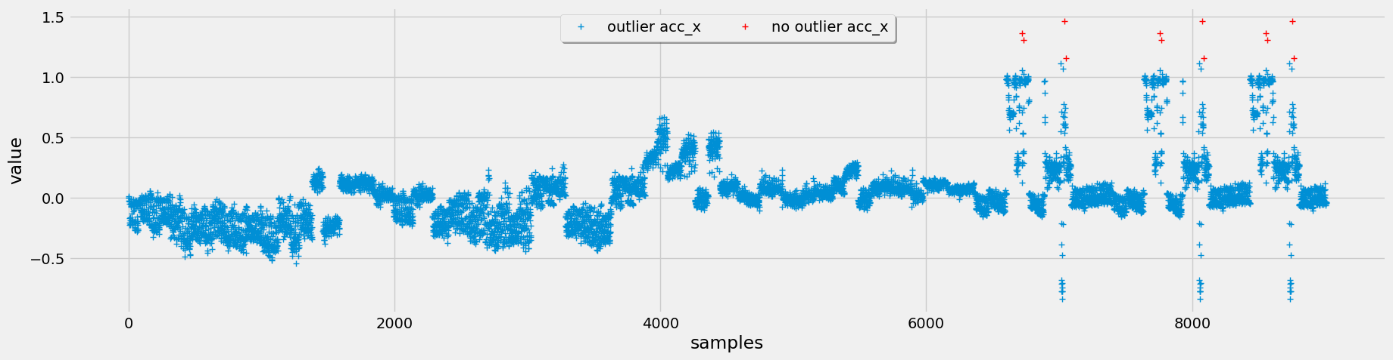
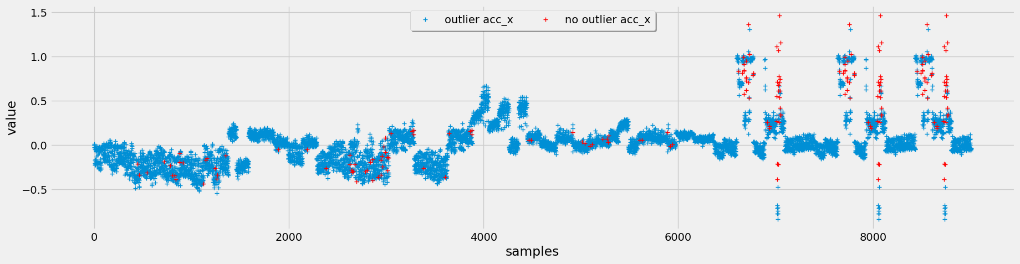
Chauvenet's Criterion Visualization:
Employed Chauvenet's Criterion to mark outliers.
Visualized outlier points with binary markers on the original data.
Local Outlier Factor (LOF) Analysis:
Applied LOF to assess local deviations and identify outliers.
Plotted binary markers to highlight detected outliers.

Slide 15
Handling Outliers - Opting for Chauvenet's Criterion:
Chose Chauvenet's Criterion over other methods due to its superior performance, especially noticeable during visualization.
Implemented Chauvenet's Criterion for handling outliers within the dataset.
Replaced identified outliers with NaN values to ensure data integrity and maintain consistency.

Slide 16
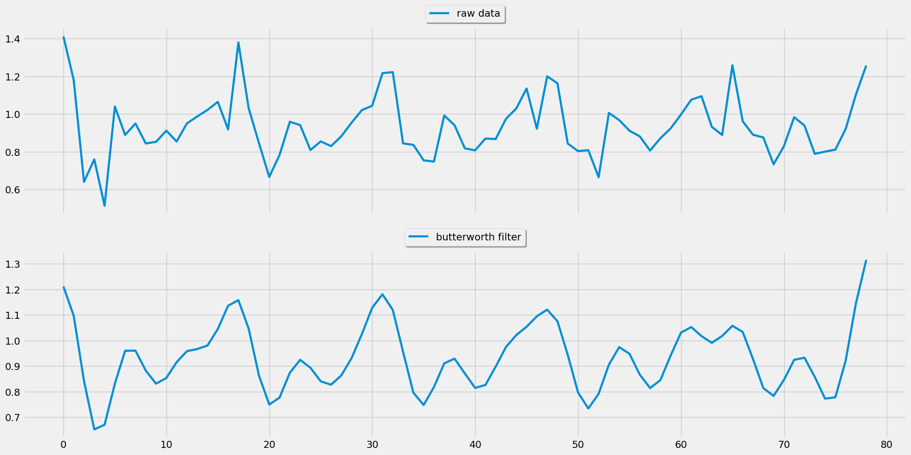
Feature Engineering
Imputation of Missing Values:
Conducted interpolation for missing values in predictor columns to ensure data completeness.
Set Duration Calculation:
Computed the duration of each set, allowing for temporal analysis.
Butterworth Lowpass Filter:
Applied a Butterworth lowpass filter to attenuate high-frequency noise, enhancing the quality of subset columns.

Slide 17
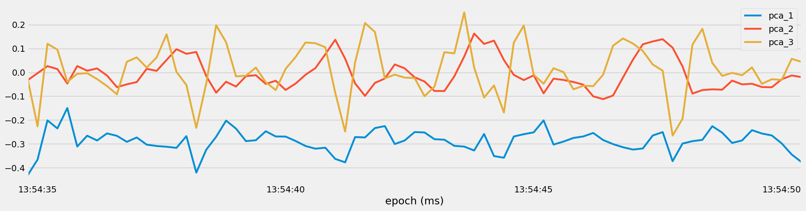
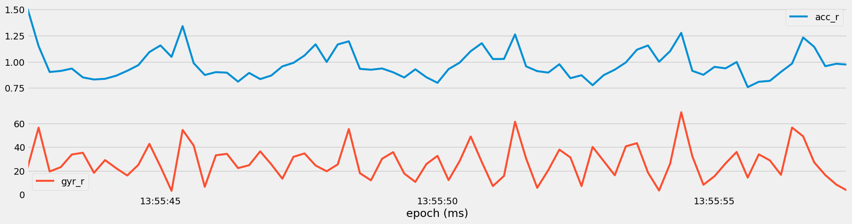
Principal Component Analysis (PCA):
Utilized PCA to reduce dimensionality, preserving essential information, and visualized the top three principal components for set 45.
Sum of Squares Attributes:
Created new attributes, 'acc_r' and 'gyr_r,' representing the magnitude of accelerometer and gyroscope data.

Slide 18
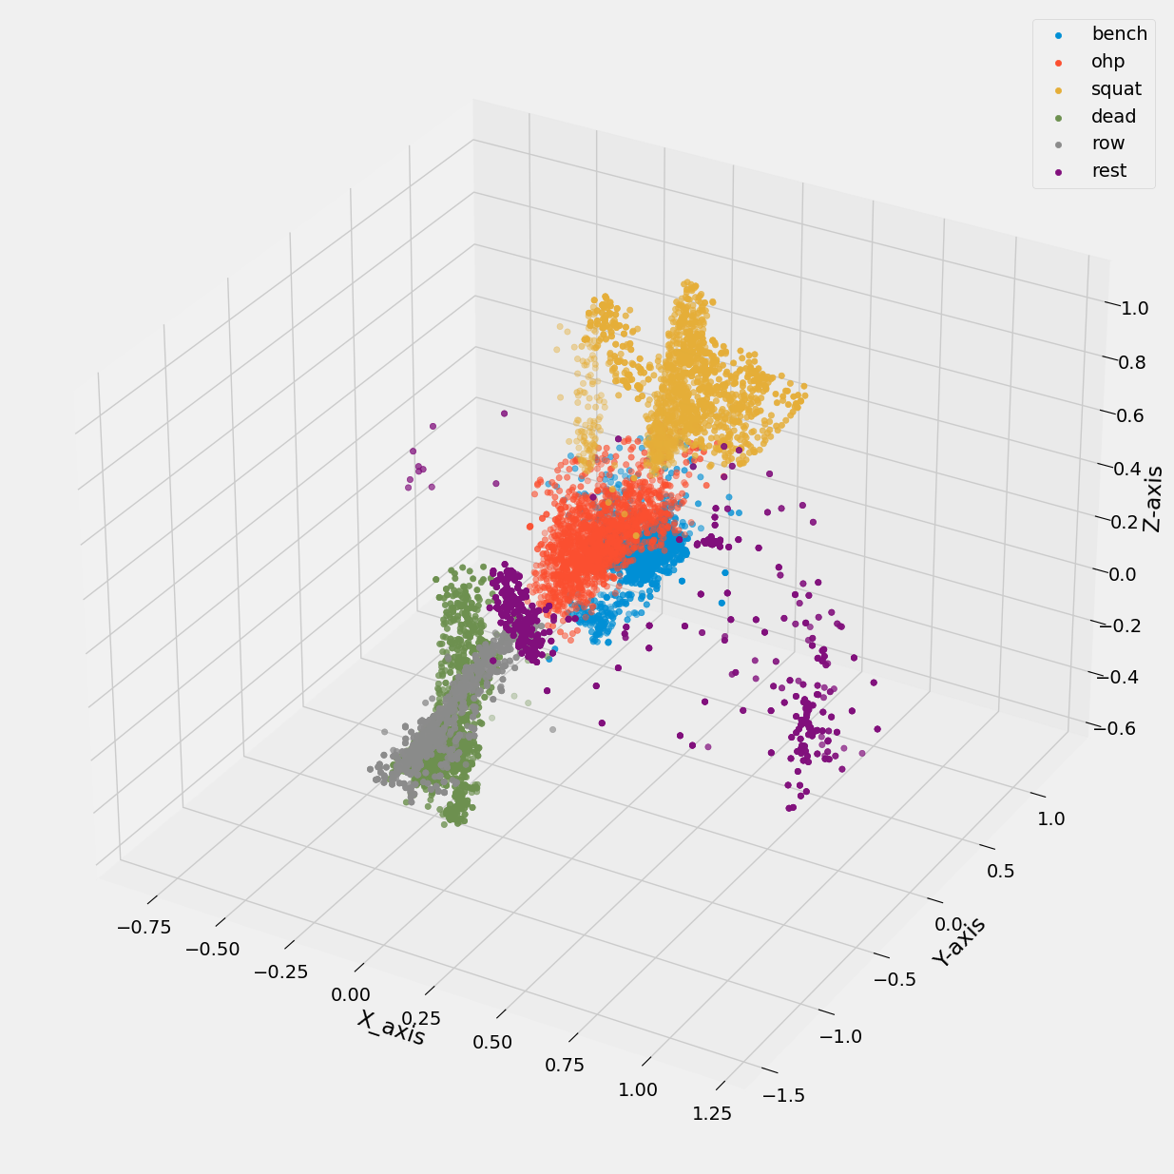
Temporal Abstraction:
Employed temporal abstraction with a window size of 5 seconds to derive mean and standard deviation features for both accelerometer and gyroscope data.
Frequency Features:
Extracted frequency-related features, such as maximum frequency, weighted frequency, power spectral entropy, and specific frequency bands.
Overlapping Windows Handling:
Addressed issues with overlapping windows, ensuring data consistency and reducing redundancy.
Clustering Analysis:
Employed KMeans clustering with varying 'k' values and visualized clusters in a 3D plot based on accelerometer data.

Slide 19
Train & Test Model
Data Splitting:
Created training and test sets from feature-engineered data.
Visualized label distribution for total, training, and test sets.
Feature Sets:
Defined multiple feature sets, including basic, square, PCA, temporal, frequency, and clustering features.
Utilized forward feature selection to identify the top features for classification.
Model Comparison:
Explored the performance of various classification models:
Neural Network (NN)
Random Forest (RF)
K-Nearest Neighbors (KNN)
Decision Tree (DT)
Naive Bayes (NB)
Conducted multiple iterations to account for non-deterministic classifiers.
Feature Set Impact:
Investigated the influence of different feature sets on model accuracy.
Analyzed accuracy scores for each model across various feature sets.

Slide 20
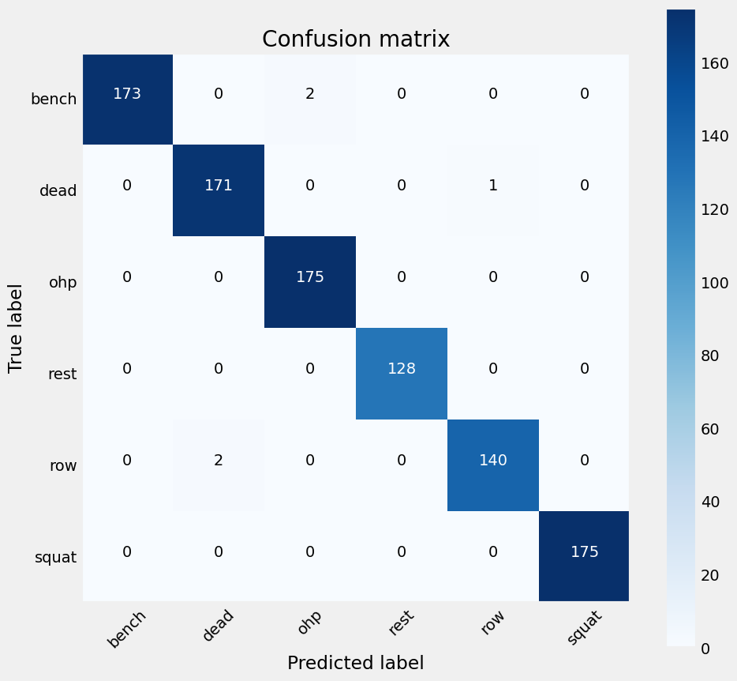
Best Model Evaluation:
Selected Random Forest as the best-performing model based on feature set 4 with accuracy of 0.99.
Evaluated accuracy and presented a confusion matrix for better understanding.
Random Forest Accuracy-0.99

Slide 21
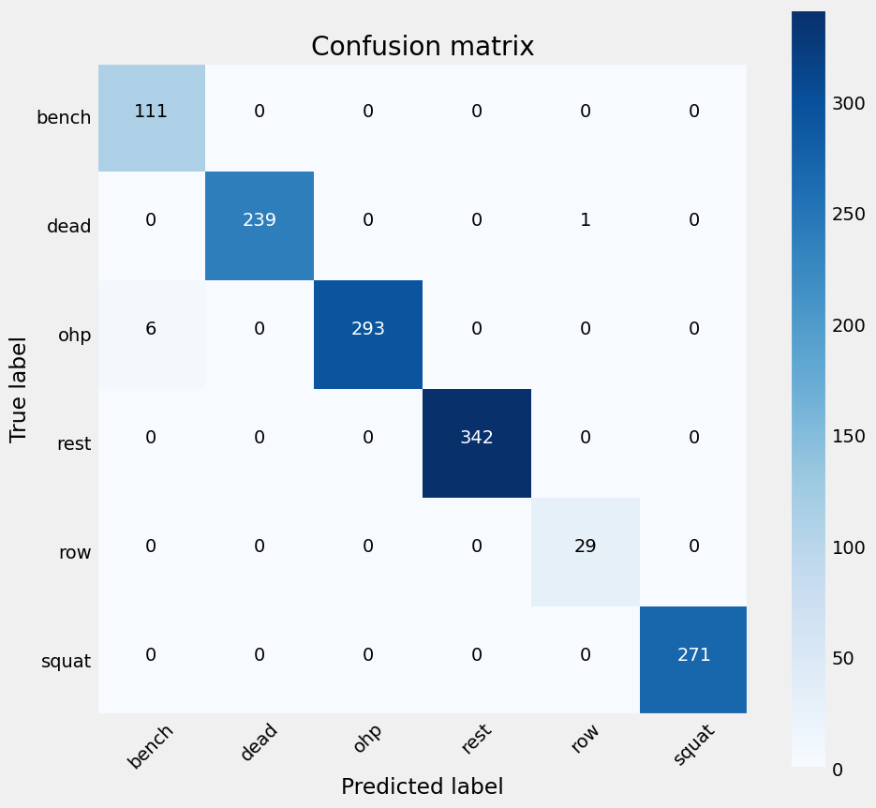

Participant-Based Analysis:
Split the dataset into training and testing subsets based on participant ('A' excluded).
Re-evaluated the Random Forest model on participant-based data.
Additionally, applied a Neural Network for comparison and assessed its accuracy.
Results and Insights:
The accuracy of RF is too good is about 0.99 and the least suitable model is KNN with accuracy of 0.78.
This Model is Capable the label the exercise very effectively by taking input data of participant.
Random Forest Accuracy-0.98
Neural Network Accuracy-0.94

Slide 22
OBSERVATIONS
model feature_set accuracy
1 RF Feature Set 4 0.993795
0 NN Feature Set 4 0.993795
1 RF Selected Feature 0.991727
0 NN Feature Set 3 0.991727
1 RF Feature Set 3 0.985522
3 DT Feature Set 4 0.984488
3 DT Selected Feature 0.981386
0 NN Selected Feature 0.972079
2 KNN Feature Set 4 0.967942
1 RF Feature Set 1 0.964840
4 NB Feature Set 4 0.963806
3 DT Feature Set 3 0.960703
1 RF Feature Set 2 0.958635
4 NB Feature Set 3 0.954498
0 NN Feature Set 1 0.937952
0 NN Feature Set 2 0.936918
2 KNN Feature Set 3 0.931748
3 DT Feature Set 2 0.930714
3 DT Feature Set 1 0.927611
4 NB Selected Feature 0.915202
4 NB Feature Set 2 0.888314
4 NB Feature Set 1 0.876939
2 KNN Selected Feature 0.830403
2 KNN Feature Set 1 0.812823
2 KNN Feature Set 2 0.798345

